Slide 1

Naan Mudhalvan -NM1009 Generative AI for Engineering
PROJECT TITLE : Heart disease analysis using RNN
Presented By :-
Name : Suruthi R
Reg No : 730321104056
Department : Computer science and engineering

Slide 2

AGENDA :
Problem Statement
Project Overview
End Users
Solution
Special Features
Modelling Approach
Results
Conclusion

Slide 3
PROBLEM STATEMENT :
Heart disease is a leading cause of mortality worldwide, necessitating accurate and timely diagnosis for effective treatment and prevention.
Traditional methods of diagnosis often rely on static measurements and do not fully leverage the sequential nature of patient data over time.
This project aims to develop a predictive model using Recurrent Neural Networks (RNNs) to analyze longitudinal patient data and accurately predict the likelihood of heart disease occurrence or progression.

Slide 4
PROJECT OVERVIEW :
project aims to develop a RNN-based system for Heart disease analysis.
Utilize a dataset containing patient demographics, medical history, and physiological measurements to train and evaluate the RNN model.
Employ an RNN architecture capable of capturing temporal dependencies within sequential patient data.
Identify areas for further research, such as model refinement, integration of additional data sources, and exploration of real-time monitoring capabilities.

Slide 5

WHO ARE THE END USERS?
Healthcare Professionals
Patients
Healthcare Institutions
Medical Researchers
Public Health Organizations

Slide 6
SOLUTION AND ITS VALUE PROPOSITION
A heart disease analysis system offers early detection, personalized risk assessment, treatment planning, and data-driven decision-making for improved patient outcomes. It also fuels research and innovation in cardiovascular health.
A recurrent neural network (RNN) for heart disease analysis offers continuous monitoring and prediction capabilities, allowing for early detection of abnormalities and personalized risk assessment. By analyzing longitudinal patient data, it provides timely interventions, personalized treatment plans, and data-driven decision-making for improved patient outcomes and resource optimization.

Slide 7
SPECIAL FEATURES :
heart disease analysis system could be real-time monitoring of vital signs and symptoms, using wearable devices or sensors, coupled with AI algorithms to detect early signs of heart issues and provide timely alerts or recommendations for medical intervention.

Slide 8
MODELLING :
Utilizing a recurrent neural network (RNN) for heart disease analysis could involve capturing temporal dependencies in patient data, such as heart rate variability over time.
The RNN could process sequences of medical data to detect patterns or anomalies indicative of heart disease progression or risk factors.
Additionally, incorporating natural language processing (NLP) capabilities could enable the model to analyze textual patient records or medical literature for further insights.

Slide 9
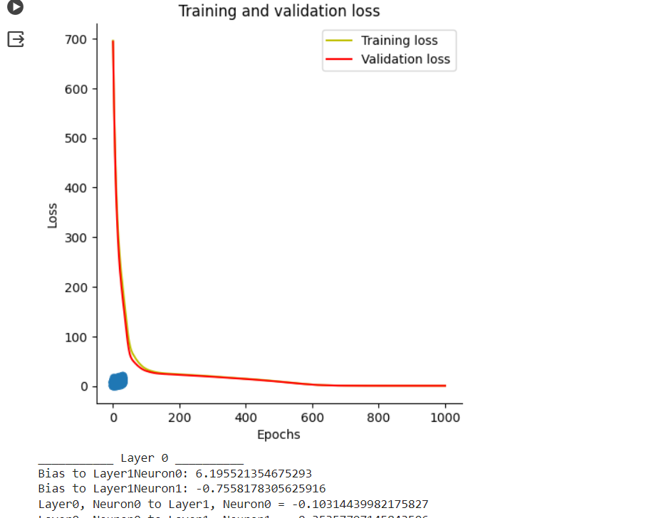
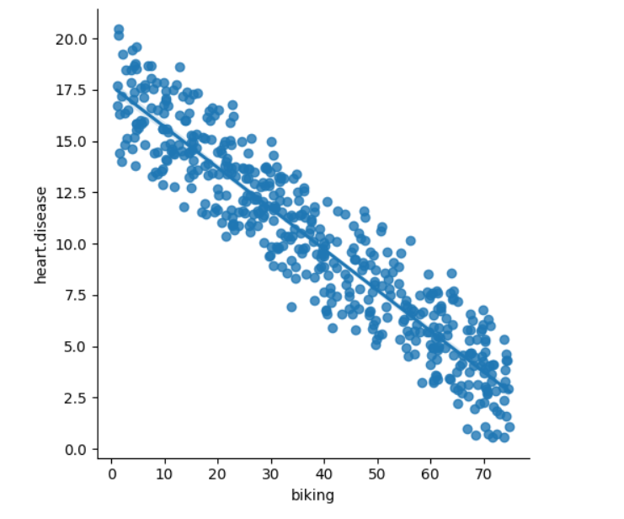
RESULTS :-

Slide 10
CONCLUSION :
In conclusion, employing a recurrent natural network (RNN) for heart disease analysis offers promising avenues for capturing temporal dependencies and linguistic nuances in medical data. By integrating recurrent neural network architecture with natural language processing capabilities, this approach enables comprehensive analysis of both structured and unstructured patient data, facilitating early detection, risk assessment, and personalized intervention strategies for heart disease management.

Slide 11

THANK YOU!!!

